Slide 1
Modifiers & Packages
Object Oriented Programming
Lecture # 10
Prepared by: Mehak Usmani

Slide 2
Content
Access or Visibility Modifiers
Packages
Data Field Encapsulation

Slide 3

Introducing Access Control
Encapsulation links data with the code that manipulates it.
Encapsulation provides another important attribute: access control. Through encapsulation, it can be controlled what parts of a program can access the members of a class. By controlling access, you can prevent misuse.
How a member can be accessed is determined by the access specifier that modifies its declaration.

Slide 4
What is a Package?
A java package is a group of similar types of classes, interfaces and sub-packages.
Package can be
built-in package
user-defined package.
There are many built-in packages such as java, lang, awt, javax, swing, net, io, util, sql etc.
Java package is used to categorize the classes and provides access protection.
The package keyword is used to create a package in java.
If a class is defined without the package statement, it is said to be placed in the default package

Slide 5
Importing a Package
There are three ways to access the package from outside the package.
import package.*; All the classes and interfaces of this package will be accessible.
import package.classname; Only declared class of this package will be accessible.
Fully qualified name. No need to import package. Fully qualified name will be required every time a class needs to be accessed. e.g. pack.A obj = new pack.A();//using fully qualified name

Slide 6
Access Modifiers
The Visibility or Access modifiers in java specifies accessibility (scope) of a data member, method, constructor or class.
They can be used to specify the visibility of a class and its members. Using the modifiers on local variables would cause a compile error.
A visibility modifier specifies how members in a class can be accessed from outside the class. There is no restriction on accessing members from inside the class.
There are 4 types of java access modifiers:
private
default
protected
public

Slide 7
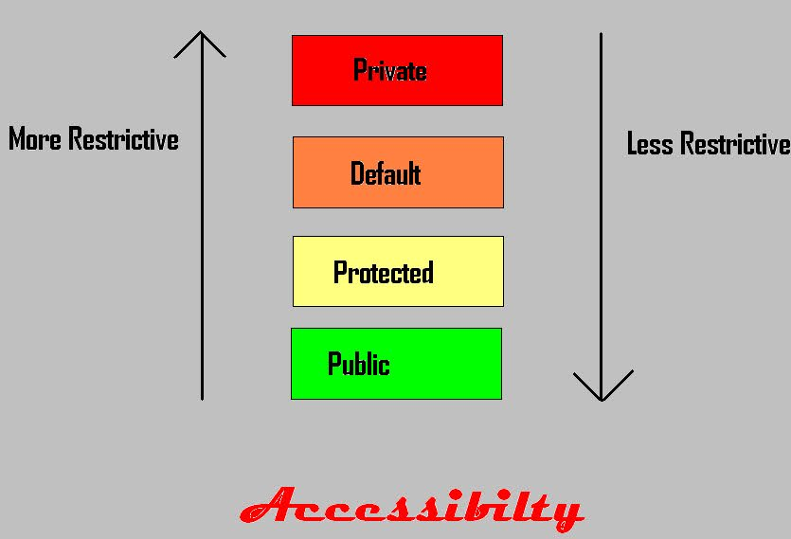

Slide 8
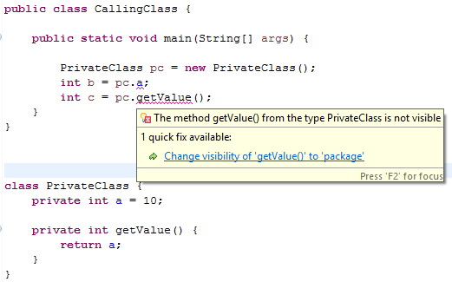
private
The private access modifier is accessible only within class.
If constructor of a class is private, the instance of that class cannot be created from outside the class. Class cannot be private.

Slide 9
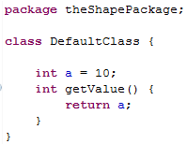
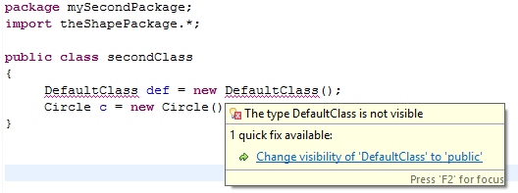
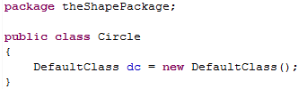
default
If no modifier is used, then it is treated as default by default.
The default modifier is accessible only within the package.
The classes, methods, and data fields present in the same package will be accessible by any class.
This is known as package-private or package-access.

Slide 10
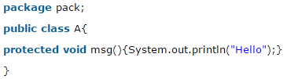
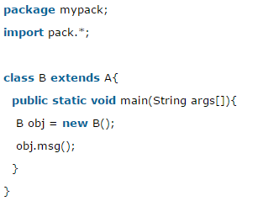
protected
The protected access modifier is accessible within package and outside the package but through inheritance only.
The protected access modifier can be applied on the data member, method and constructor.
It can't be applied on the class.

Slide 11
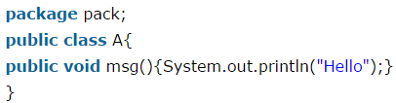
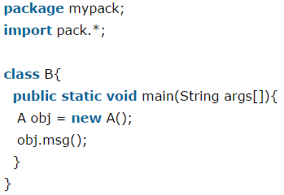
public
The public access modifier is accessible everywhere.
It has the widest scope among all other modifiers.
Public classes, methods, and data fields can be accessed from any other classes.

Slide 12
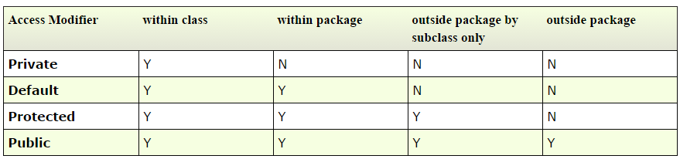
conclusion
The private modifier restricts access to its defining class, the default modifier restricts access to a package, and the public modifier enables unrestricted access.

Slide 13
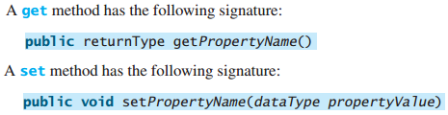
Data Field Encapsulation
Making data fields private protects data and makes the class easy to maintain.
To prevent direct modifications of data fields, the data fields should be declared as private, using the private modifier. This is known as data field encapsulation.
To make a private data field accessible, provide a get method to return its value. To enable a private data field to be updated, provide a set method to set a new value. A get method is referred to as a getter (or accessor), and a set method is referred to as a setter (or mutator)

Slide 14
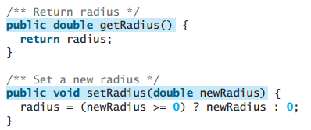
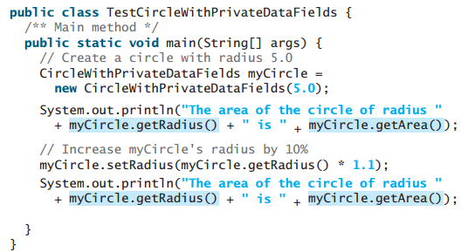
Getter/Setter Example

Slide 15
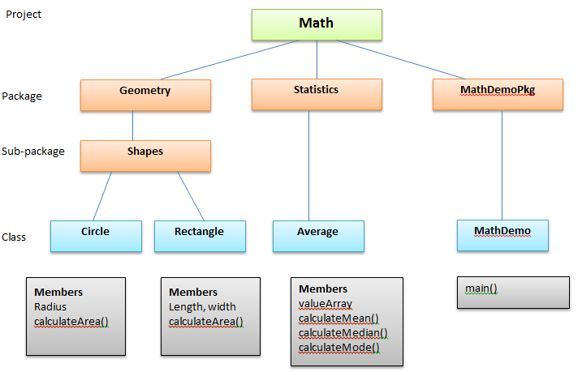
Let’s write code!

